Slide 1
Documentation Lead Role
Edgar Juarez
Team:Tech Titans

Slide 2
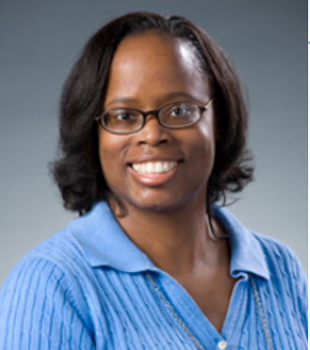
Dr. Hammonds-Odie
Dr.Hammonds-Odie is an associate Professor of Biology. As a teacher and researcher, she wants undergraduate students to discover the joys and challenges of basic science research. She believes student learning should include improving basic social and communication skills. She has taken great pride in listening to students present their own research in a competent and professional manner.

Slide 3
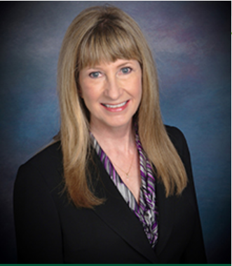
Dr.Pollacia
Dr. Lissa Pollacia is a professor of information technology and assistant dean of the School of Science and Technology. She holds a master's degree in both mathematics and computer science, and a Ph.D. in computer science. She has many years of teaching experience, has served as principal investigator for numerous research grants, and published many journal articles and papers. She is the national coordinator for AITP’s Database Design contest at the National Collegiate Conference (NCC).

Slide 4
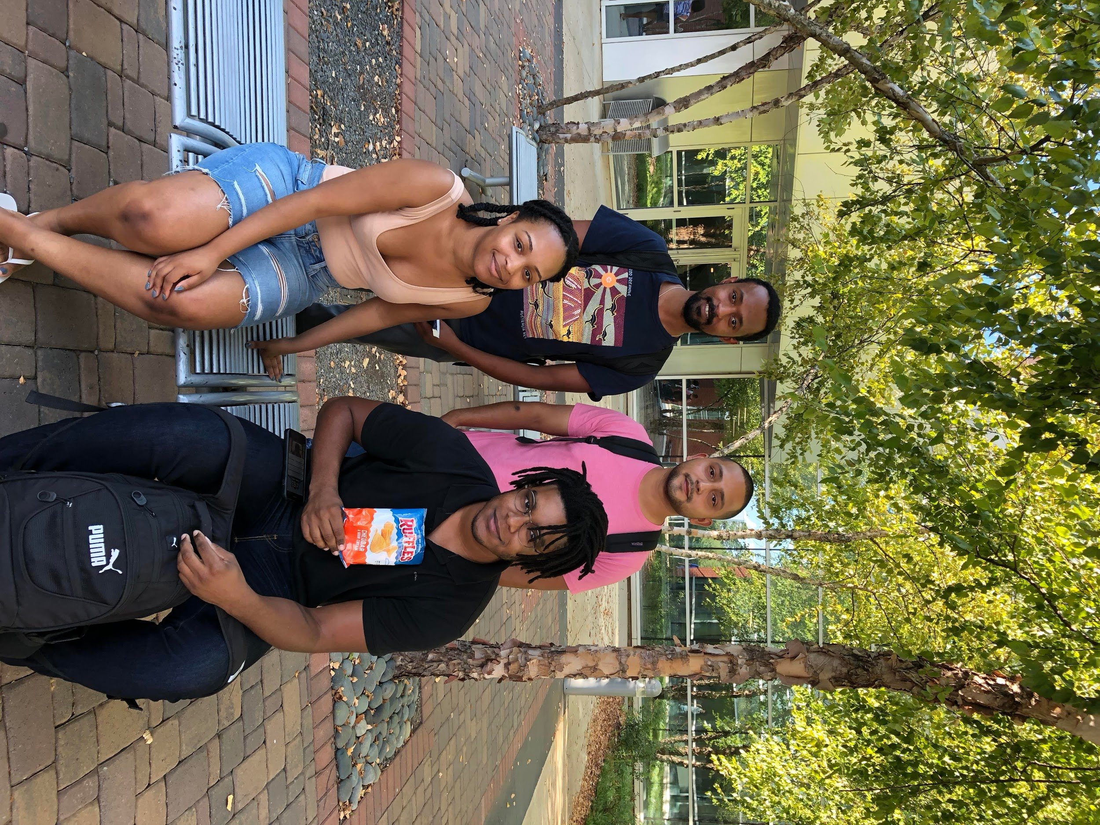
Team Photo
Left Back: Kidus
Right Back: Edgar
Left Front: Anastasia
Right Front: Billy

Slide 5
Plans for User
Documentation
GitHub will contain all documentations necessary for developers and users
Developers Will Have:
Requirements Documentation
Code Documentation
Users Will Have:
Installation Documentation
System Requirements Documentation
Tutorial Documentation

Slide 6
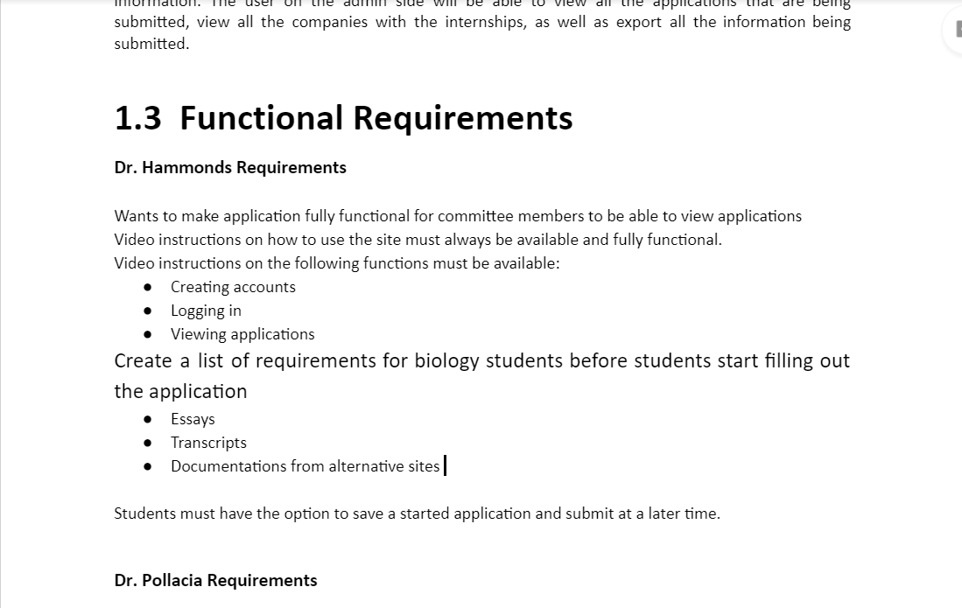
Developer Documentation
Requirements Documentation
All Functionational and Non-Functional Requirements

Slide 7
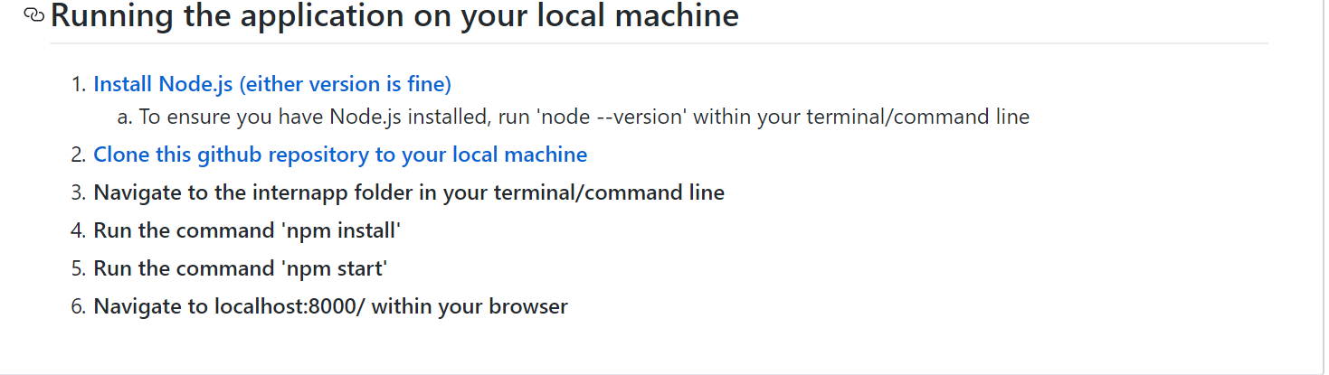
User Documentation
Installation Documentation
-Step by step instructions on how to install the software on their system
Tutorial Documentation
-Basic instructions on how to interact within the intern app.
Other User Guides
-Other documentation that might be useful for using/installing app.

Slide 8
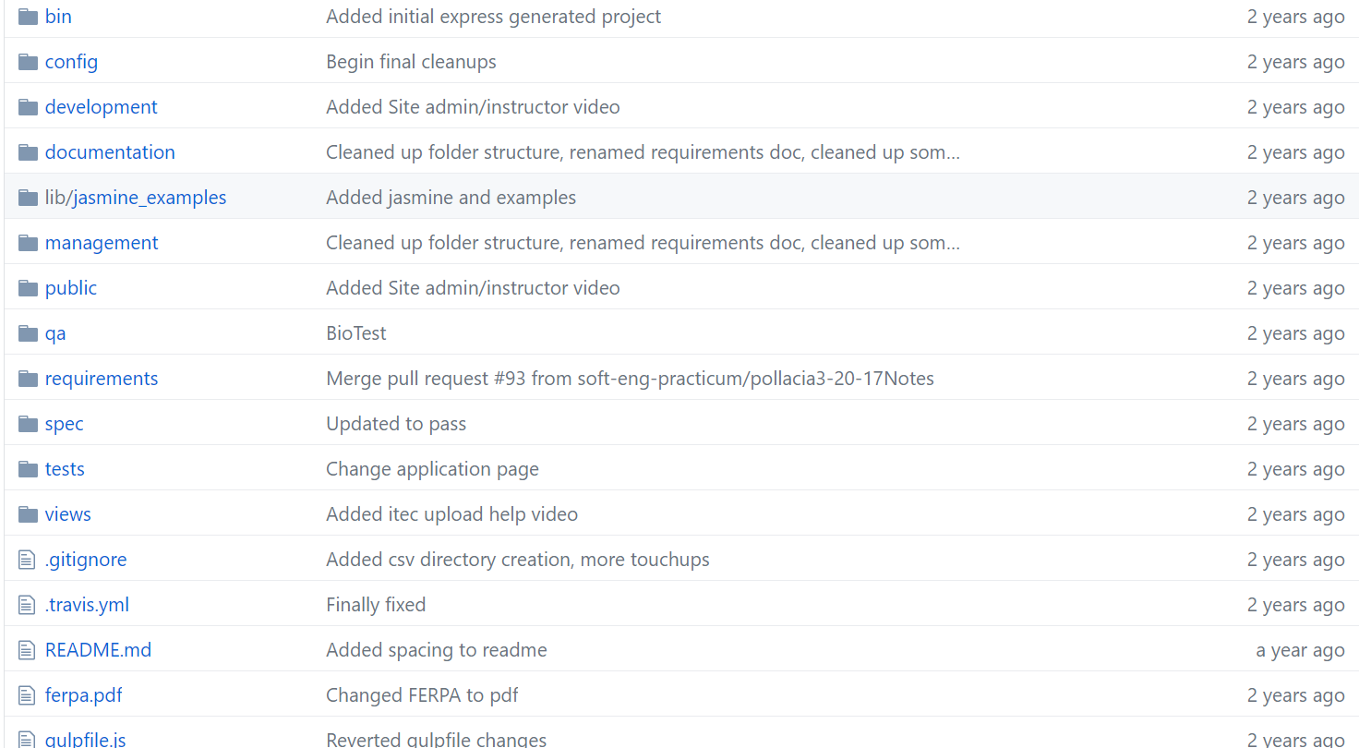
Github Repo Documentation Organization
All documentation will be added to the GitHub Repo where all the required documents will be located.

Slide 9
Demonstration
https://youtu.be/RAlKefKoB7c

